Slide 1
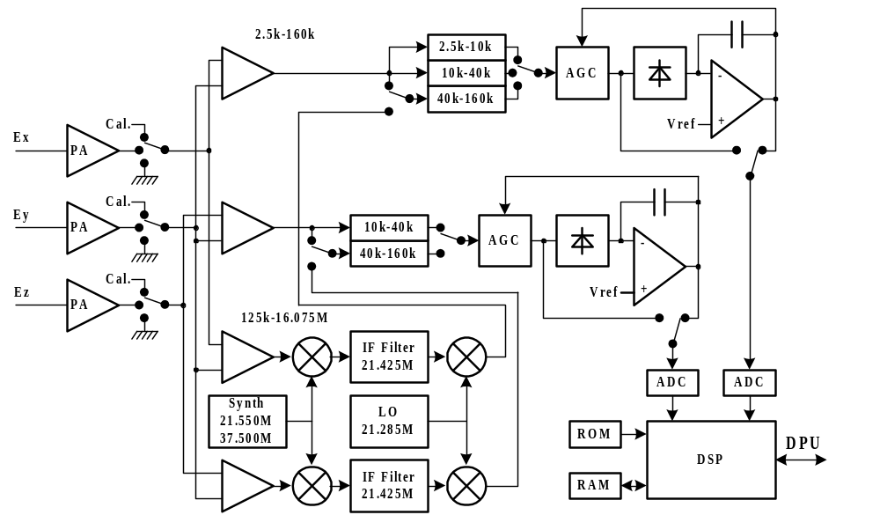
Swaves bloc diagram

